Slide 1
GROUP 19
NLP SYSTEM FOR CREATING JOB DESCRIPTION

Slide 2
Team Members
2019AIML592 Akanksha Nagar
2019AIML673 Chandrika
2019AIML684 Manoj Avirineni
2019AIML511 Sriram P R
2019AIML585 Jayashree Namasivayam
MENTOR: SUDHARSHAN DESHMUKH

Slide 3

Problem Statement
Introduction: Job description is important to understand the requirement. Inconsistent job descriptions lead to improper selection which affects the ROI. Based on Role and years of experience, an AI based solution is expected to write the job description so that it will avoid the above-mentioned problem.

Slide 4
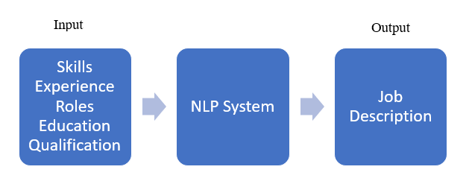
Objective
To Implement a Natural Language based solution which will write the job description based on some given criteria. For example, Given a Roles, Responsibilities and Technology, Tools data, the model should be able to generate the relevant job description.

Slide 5
Index
1.Data flow diagram
2.Data Scraping
3.Exploratory Data Analysis
4.Terms – Data Cleaning
5.Dataset view
6.Approach
7.Text cleaning
8.Data embedding
9.Transformers
10.Interpretation

Slide 6
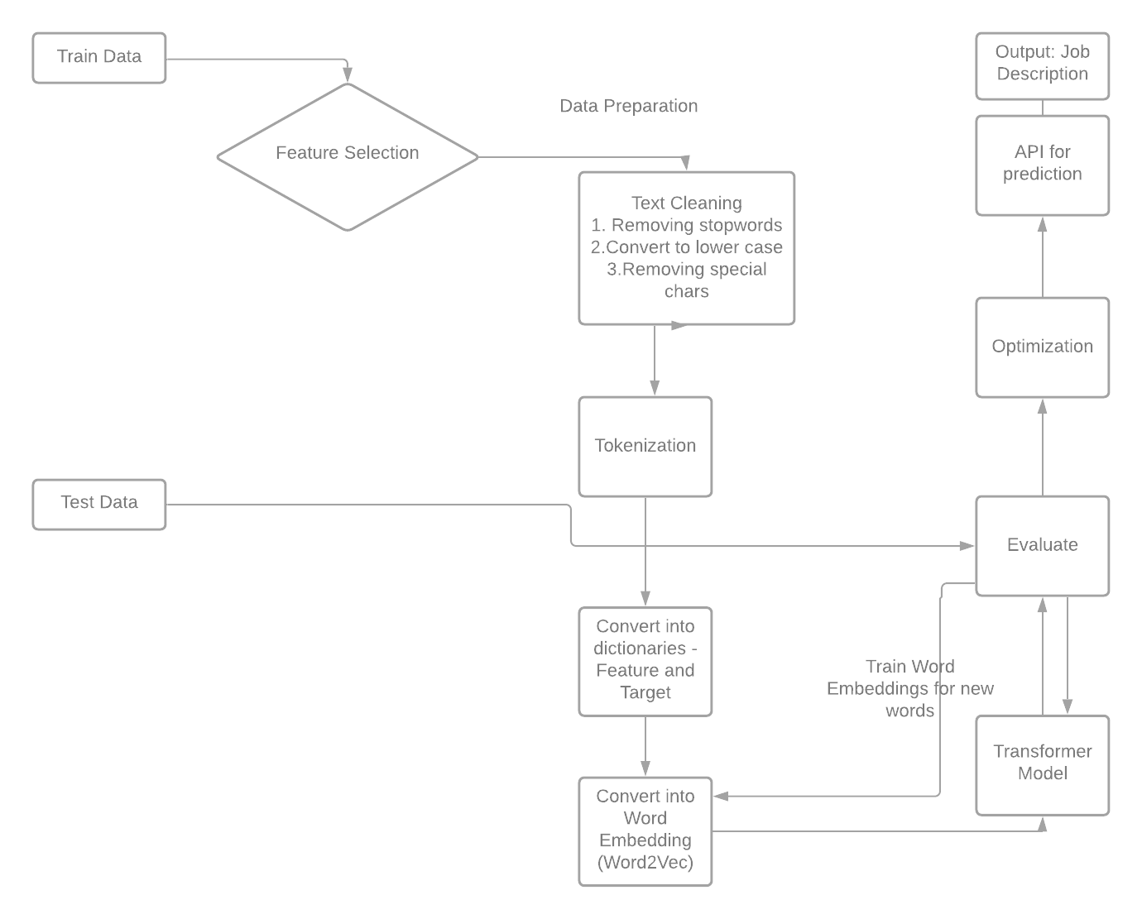
1. Data Flow Diagram

Slide 7
2. Data Scraping
1.We performed scraping of job description relevant to the roles in scope.
2.We prepared code to accept inputs and return the job descriptions for the inputs, so that we could fetch data based on our requirements.

Slide 8
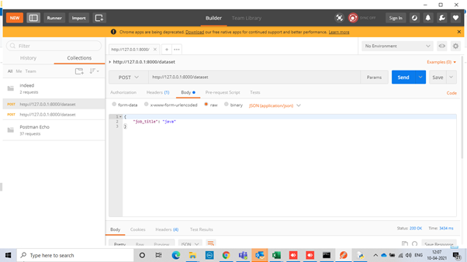
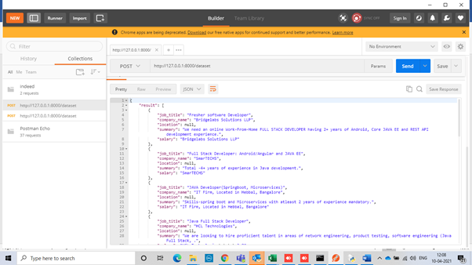
2. Data Scraping

Slide 9
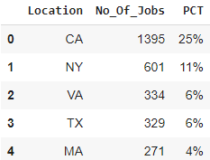
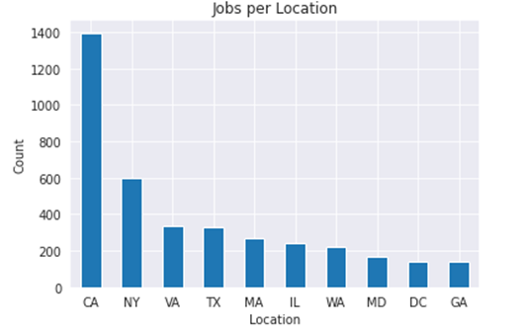
3. Exploratory Data Analysis
Jobs Across Location

Slide 10
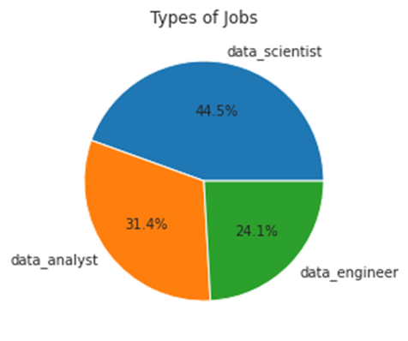
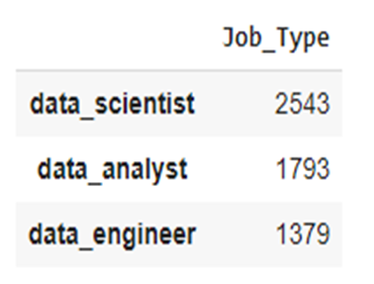
3. Exploratory Data Analysis
Job Designation in Demand

Slide 11
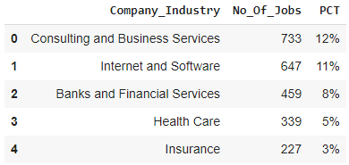
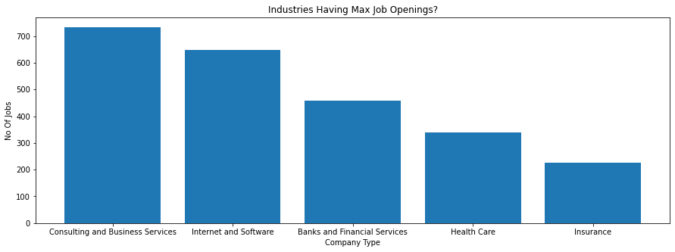
3. Exploratory Data Analysis
Any industry on a hiring surge

Slide 12
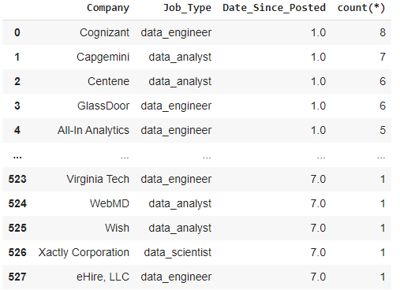
3. Exploratory Data Analysis
Most recent job openings

Slide 13
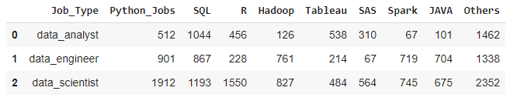
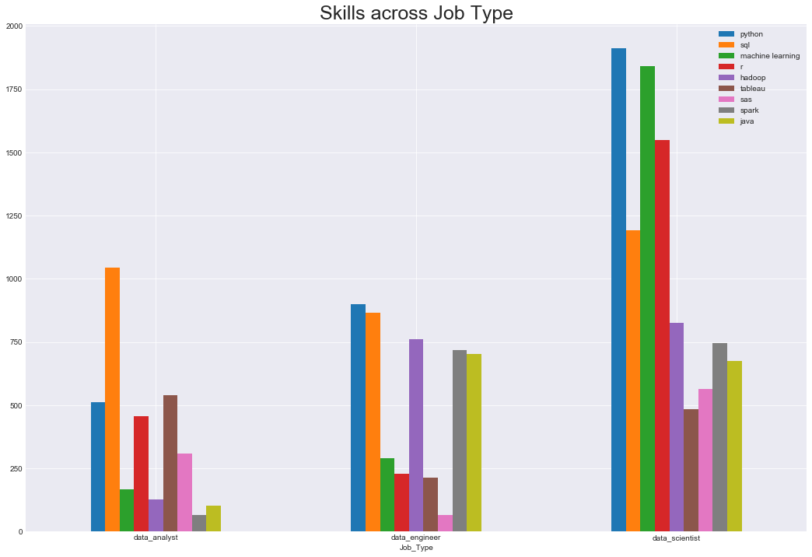
3. Exploratory Data Analysis
Most popular skills as per job type

Slide 14
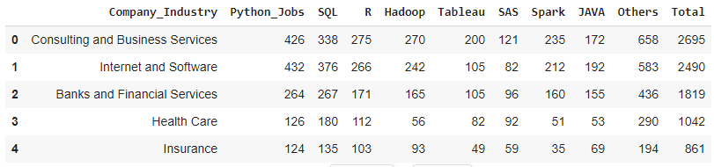
3. Exploratory Data Analysis
Top skills across industry

Slide 15
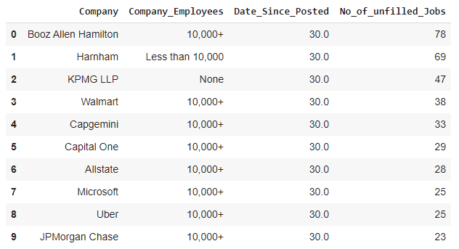
3. Exploratory Data Analysis
Bigger corporates have harder time filling the job?

Slide 16
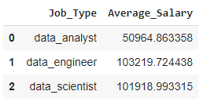
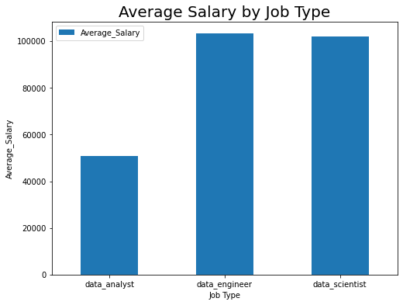
3. Exploratory Data Analysis
Average Salary by Designation

Slide 17
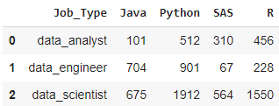
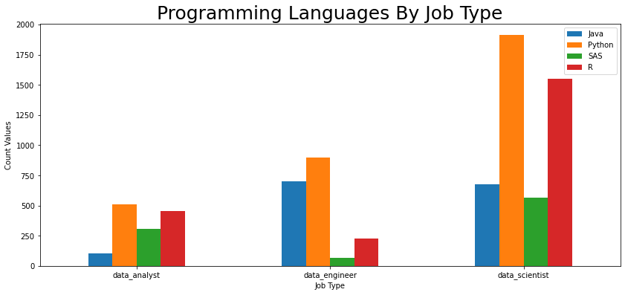
3. Exploratory Data Analysis
Programming language

Slide 18
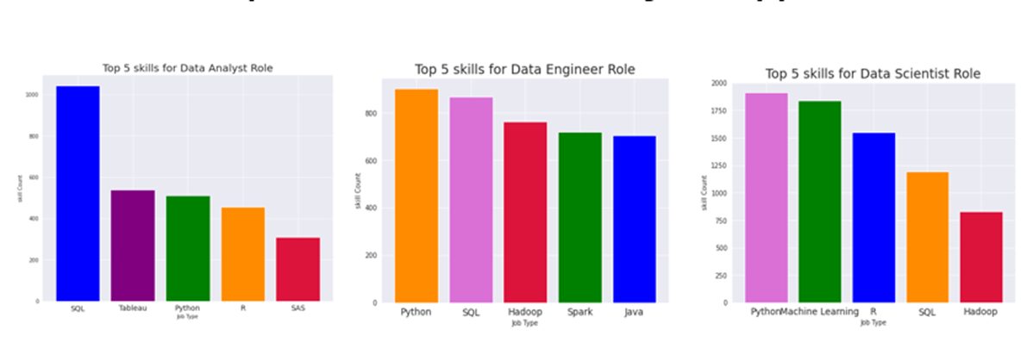
3. Exploratory Data Analysis
Demand Skills for Each Job Role

Slide 19
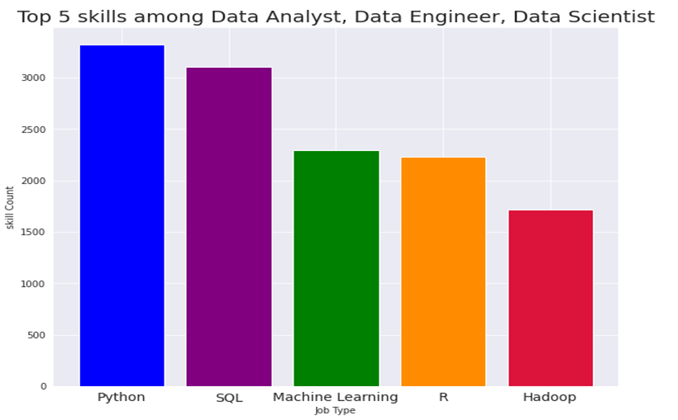
3. Exploratory Data Analysis
Common Demand Skills for Each Job Role

Slide 20
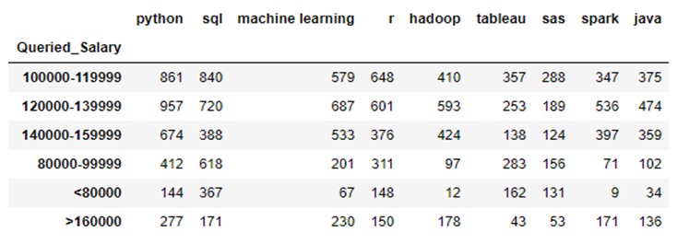
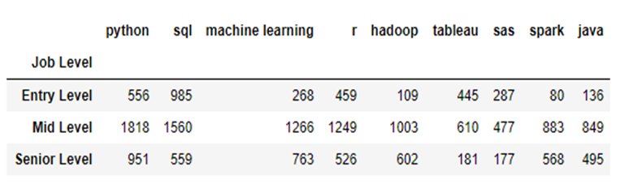
3. Exploratory Data Analysis
Relationship between Job Salaries, Skills and Career Level

Slide 21
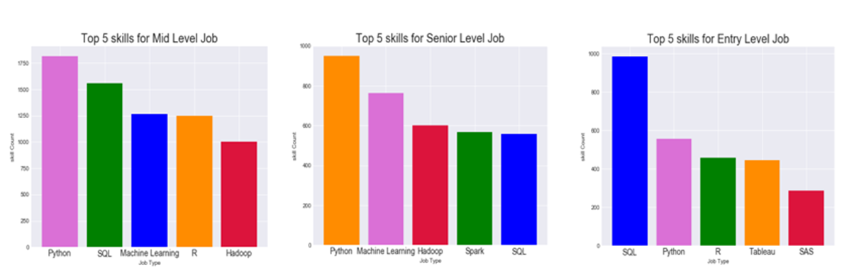
3. Exploratory Data Analysis
Demand Skills by Career Level

Slide 22
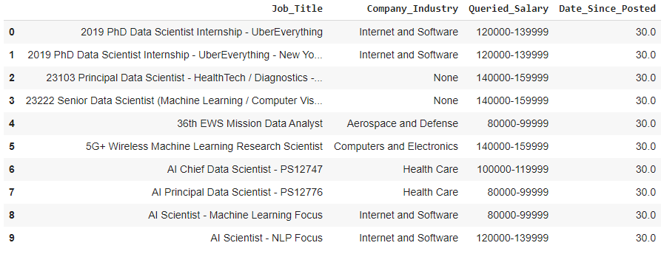
3. Exploratory Data Analysis
Hard to fill position

Slide 23
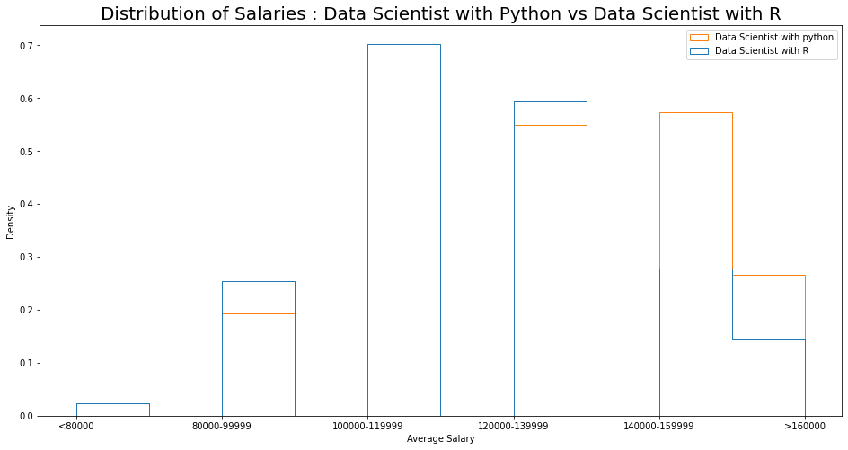
3. Exploratory Data Analysis
Data Scientist: Python Vs R

Slide 24
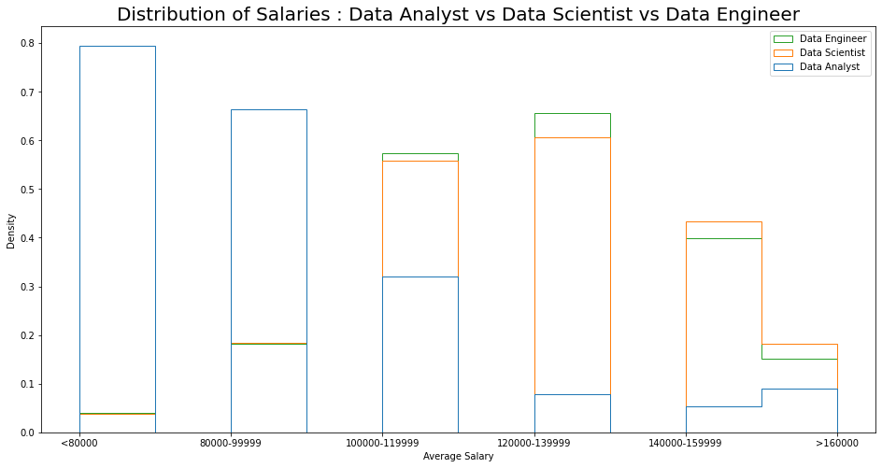
3. Exploratory Data Analysis
Data Analyst vs Data Scientist vs Data Engineer

Slide 25
4. Terms - Data cleaning
•Normalization
•lower or upper case
•converting numbers into words or removing numbers
•removing punctuations, accent marks etc
•removing white spaces
•removing stop words, sparse terms, and particular words

Slide 26
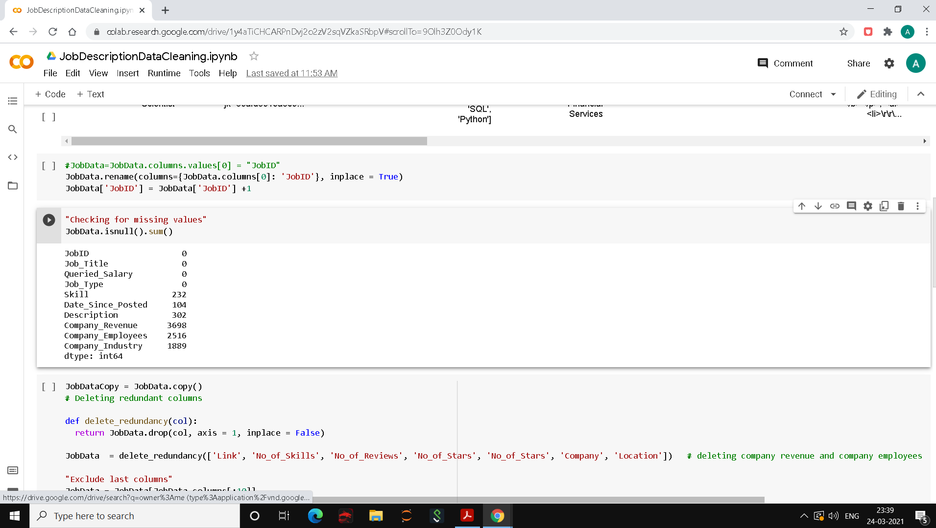
4. Terms - Data cleaning
Removing Redundancy

Slide 27
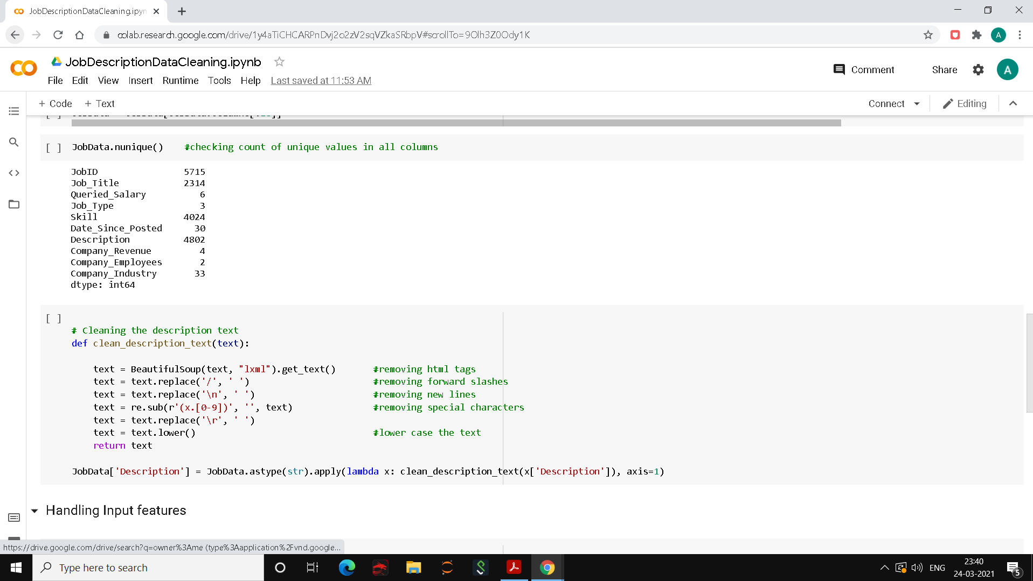
4. Terms - Data cleaning
Checking unique values and cleaning Job Description

Slide 28
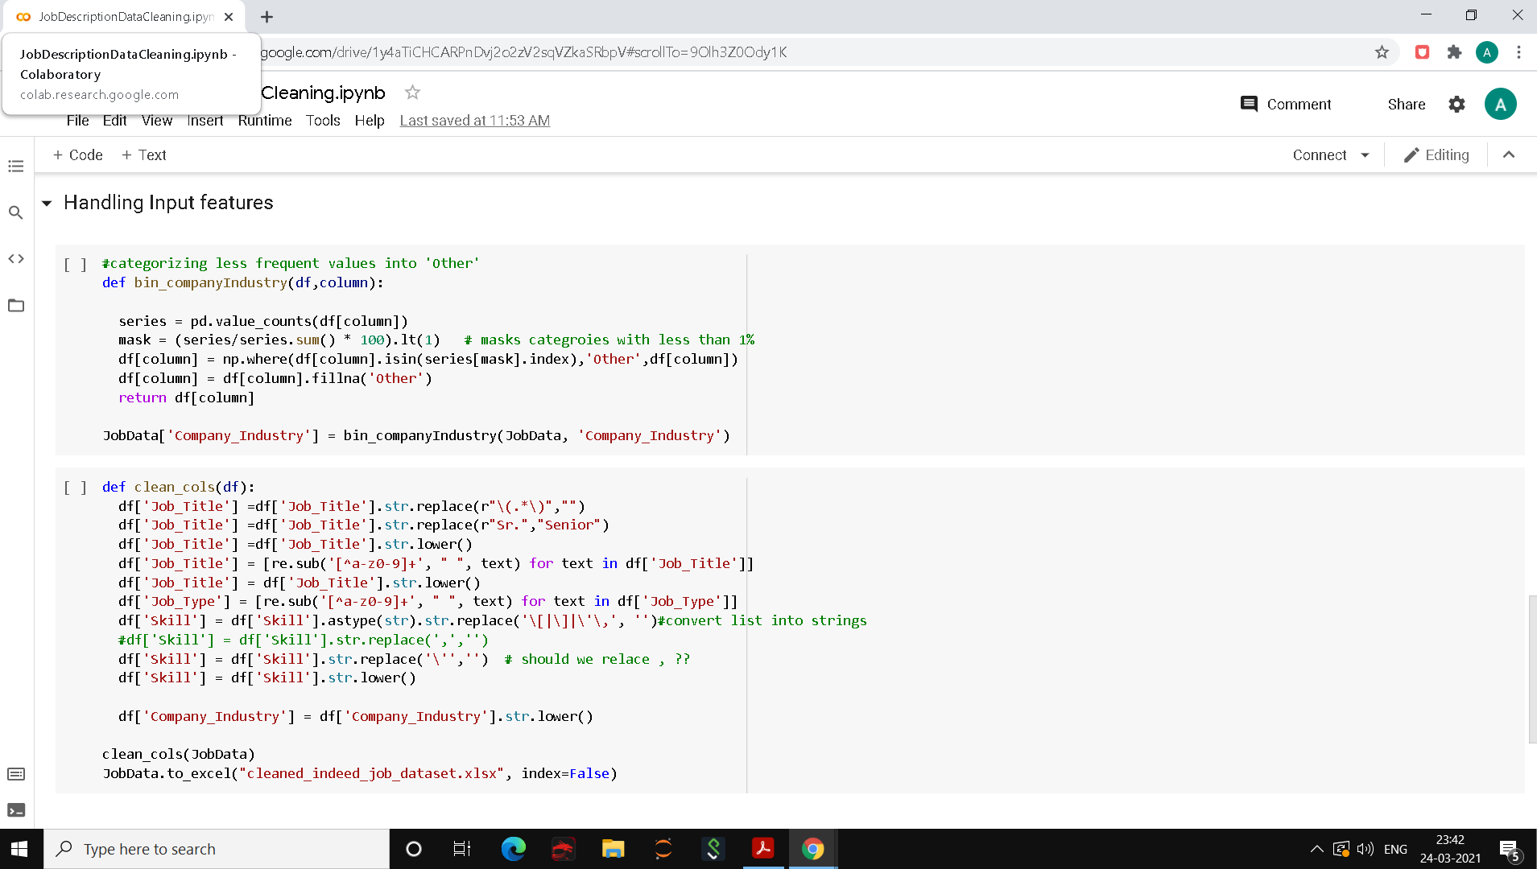
4. Terms - Data cleaning
Cleaning Input columns and saving the clean dataset to an excel.

Slide 29
5. Dataset view
•Total Columns
Job_Title,Link,Queried_Salary,Job_Type,Skill,No_of_Skills,Company,No_of_Reviews,No_of_Stars,Date_Since_Posted,Description,Location,Company_Revenue,Company_Employees,Company_Industry,python,sql,machine learning,r,hadoop,tableau,sas,spark,java,Others,CA,NY,VA,TX,MA,IL,WA,MD,DC,NC, Other_states, Consulting and Business Services, Internet and Software, Banks and Financial Services, Health Care, Insurance, Other_industries
•Redundant columns
'Link', 'No_of_Skills', 'No_of_Reviews', 'No_of_Stars', 'Company', 'Location','Company_Revenue', 'Company_Employees’
python,sql,machine learning,r,hadoop,tableau,sas,spark,java,Others,CA,NY,VA,TX,MA,IL,WA,MD,DC,NC, Other_states, Consulting and Business Services, Internet and Software, Banks and Financial Services, Health Care, Insurance, Other_industries

Slide 30
6. Approach
Exploratory Data Analysis
Text Cleaning
We will remove redundant columns
We will parse the description column to get various derived columns such as
Skills required, roles and responsibilities required, experience required, company description etc
Word Embedding
Transformers

Slide 31
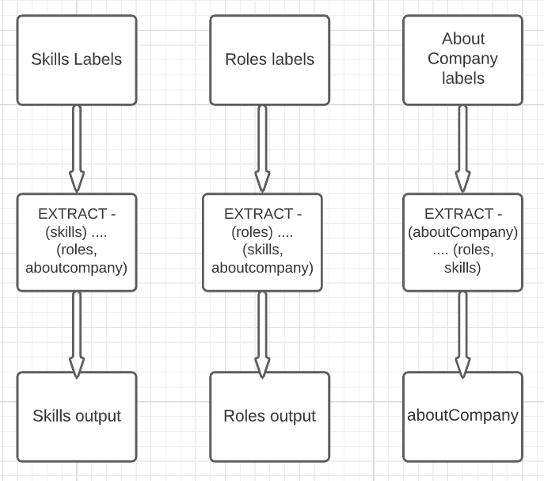
7. Data Segregation

Slide 32
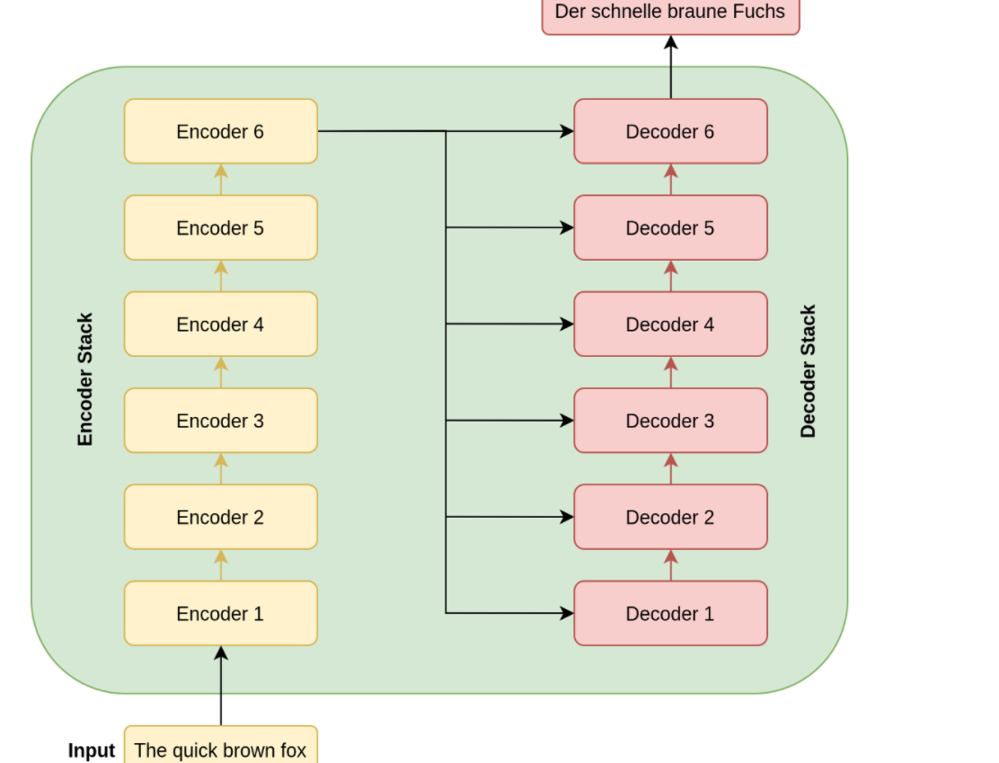
8. Attention All you need?
Transformers

Slide 33
9. Transformers
•We plan to have 3 transformers as of now. Basically, for every section of the description we generate, there will be one transformer responsible.
•Each transformer will work to generate a different part of the description
For eg, 1 transformer will take the input of skills and generate the skill required section
Another transformer will take the input of experience and generate the experience required section
And another one, will take roles and responsibilities as in input and will generate corresponding output section.

Slide 34
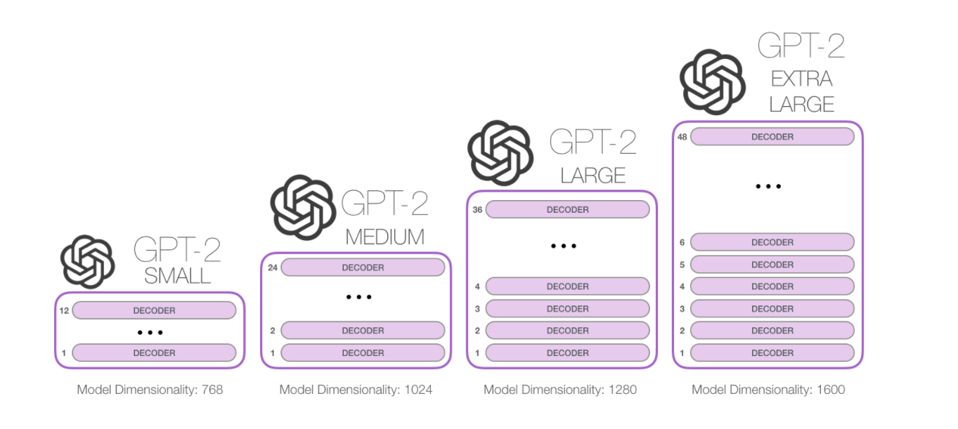
9. Transformers – GPT2

Slide 35
9. Transformers – GPT2
Approach
We have separated output into 3 sections.
Job Description -
1. Skills required
2. Roles and responsibilities
3. About Company
We have one GPT2 model for each section. The first model takes Input as Skills and Job Title
and Is going to predict the first section. Similarly, the second one takes Input as Skills and Job
Title and predicts the second section. And the third model will take Location and company
name as in Input and predict the third section.
We combine the outputs from all models to have our desired Job Description ready

Slide 36
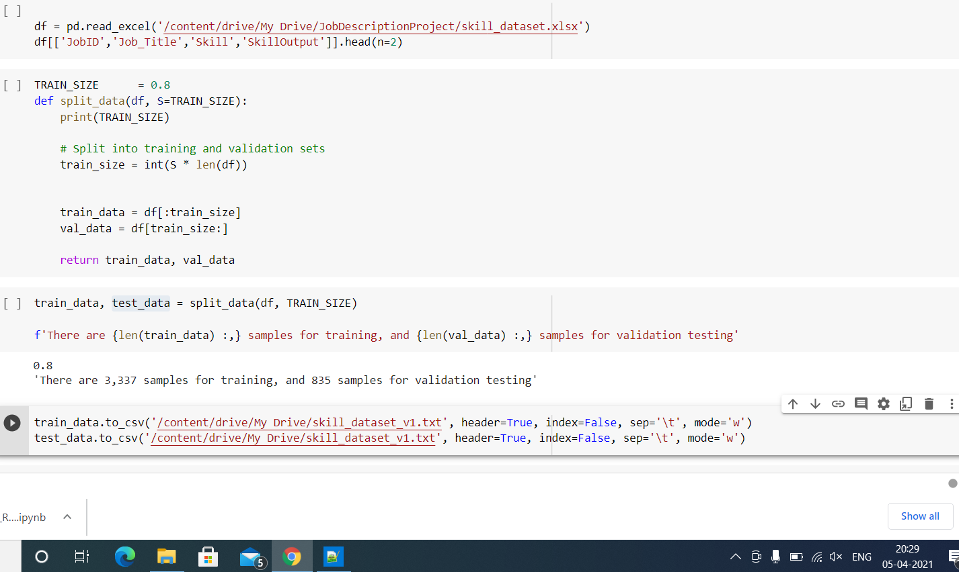
9. Transformers – GPT2

Slide 37
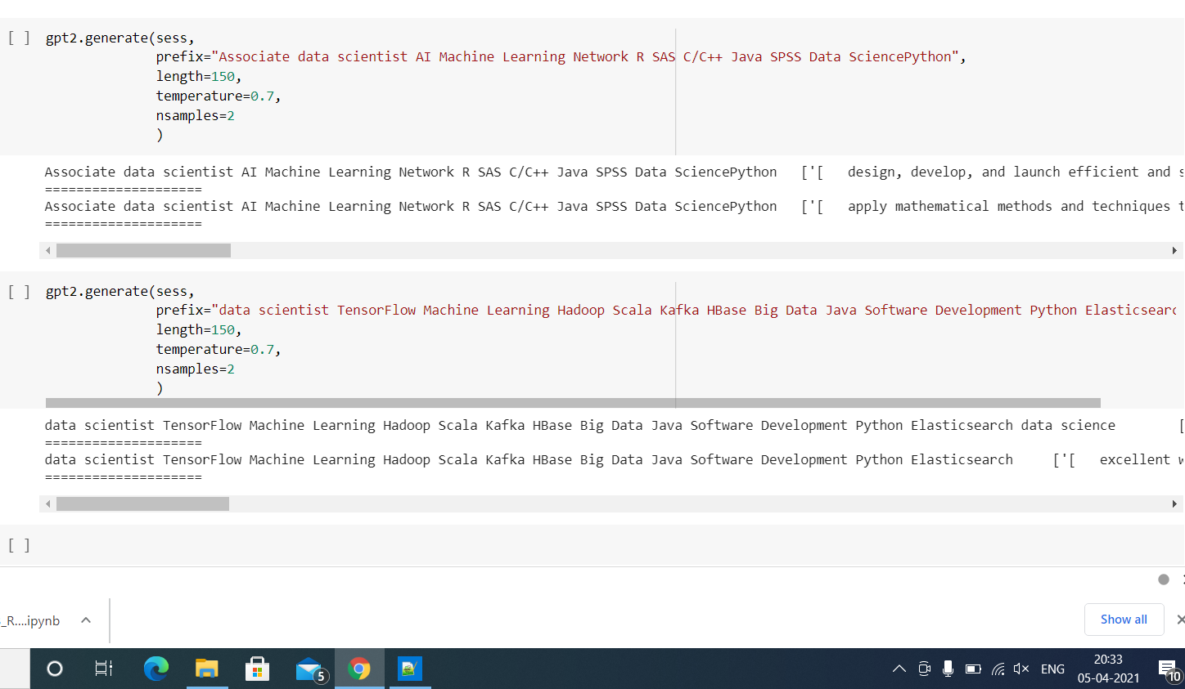
9. Transformers – GPT2

Slide 38
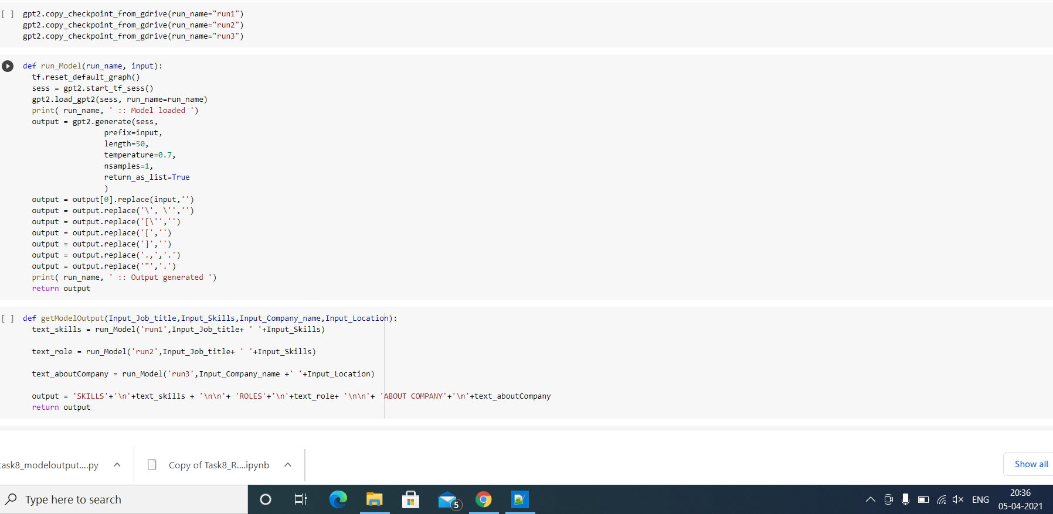
9. Transformers – GPT2

Slide 39
10. Model Evaluation
1.Metrics used – Cosine similarity Matrix
2.Project Output in terms of cosine metrics – output on an average was 0.25

Slide 40
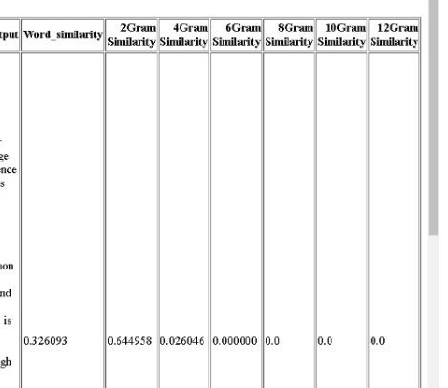
10. Interpretation

Slide 41

Questions

Slide 42
Appendix

Slide 43
Data challenges & risks in doing the project
Most of the real-world data is messy, some of these types of data are:
● Missing data: Missing data can be found when it is not continuously created or due to
technical issues in the application. Many columns had more than 80% missing data.
These columns were deleted. Few columns such as Company, Industry also have a
significant amount of missing values, but since we needed this column as an input, we
created another category - ‘Other’ and filled missing rows with this value.
● Inconsistent data: This type of data might be collected due to human errors (mistakes
with the name or values) or duplication of data. For example, for Job Title, few values
were similar, such as Sr. and Senior. So to avoid biases in our model, we cleaned this
column to standardize our column values.
● Redundant data: There were several highly correlated columns in our dataset, such as
No of Skills, One hot encoded skills values. So to reduce the dimensionality of our
dataset and decrease redundancy, we deleted these columns.

